Slide 1


NEXT GEN EMPLOYABILITY PROGRAM
CREATING A FUTURE-READY WORKFORCE
Student Name :
ALWIN BENNY
Student ID :
College Name :
STU65b1ec0514ff41706159109
LBS COLLEGE OF ENGINEERING
Notes:
<number>

Slide 2
CAPSTONE PROJECT SHOWCASE
Project Title
BenalvyMusic
Abstract | Problem Statement | Project Overview | Proposed Solution | Technology Used | Modelling & Results | Conclusion | Q&A

Slide 3
Abstract
1
Our music website aims to revolutionize the way users discover, enjoy, and support music, with a focus on empowering independent artists and fostering community engagement.
2
Featuring personalized playlists, artist showcases, and interactive fan engagement tools, our platform offers a seamless and immersive music experience for users
3
By integrating reward incentives for frequent users and leveraging cutting-edge technologies like ChatGPT and Gemini, we aim to incentivize continued usage and enhance user retention.
4
With a commitment to continuous improvement and user feedback, we strive to evolve into a premier destination for music discovery, community interaction, and artist support.

Slide 4


Problem Statement
The music industry is experiencing a shift towards digital consumption, with streaming services dominating the market. However, there remains a need for platforms that cater to niche genres and emerging artists.
My research indicates that music enthusiasts crave a personalized listening experience, with access to a wide range of music across different genres, languages, and cultures. Additionally, artists seek platforms that offer better visibility and monetization opportunities.
My target audience includes music enthusiasts seeking a diverse and immersive listening experience, as well as independent artists looking to reach new audiences and build meaningful connections. By catering to these distinct groups, we aim to create a platform that resonates with a wide range of users.

Slide 5

Project Overview
My project aims to develop a music website catering to diverse audiences and supporting independent artists. Key objectives include increasing user engagement, promoting artist discovery, and fostering a vibrant music community. Currently, the website is in its initial phase with limited features.
The website will offer personalized playlists, live sessions, and direct artist interaction. I'll utilize a modern technology stack, including robust streaming infrastructure and advanced recommendation algorithms, to deliver a seamless user experience.
I'll adopt an agile development approach, setting milestones including platform development, beta testing, and launch preparation. As the sole developer, I'll handle all aspects of the project, from coding to design and deployment.

Slide 6
Proposed Solution
I’ve incorporated features like personalized playlists and artist showcases to make music discovery enjoyable and effortless for users.
As a solo developer, I’ve ensured that artists can easily create profiles, share their music, and earn money directly from fans, empowering them to grow their careers on the platform.
I’m creating a welcoming environment where music enthusiasts can connect, share their favorite tracks, and engage with artists, fostering a supportive and lively community.
I’ve designed the website with simplicity in mind, making it easy for users to navigate, discover new music, and engage with features, even on their first visit.
I’ll regularly update the website based on user feedback and emerging trends, ensuring that it remains fresh, relevant, and exciting for both users and artists.

Slide 7
Technology used
Design Tools: For designing the website, I utilized Figma, a user-friendly design tool, to create intuitive and visually appealing interfaces.
Frontend Development: In frontend development, I employed HTML, CSS, and JavaScript to craft the user interface and ensure a seamless browsing experience for visitors.
Backend Framework: For the backend functionality, I chose Django, a powerful and versatile web framework, to handle tasks such as user authentication, database management, and server-side logic.
Additional Integrations: In addition to the core technologies, I integrated other tools and sources such as ChatGPT and Gemini to enhance the website’s functionality and provide unique features like chatbots and cryptocurrency transactions.

Slide 8
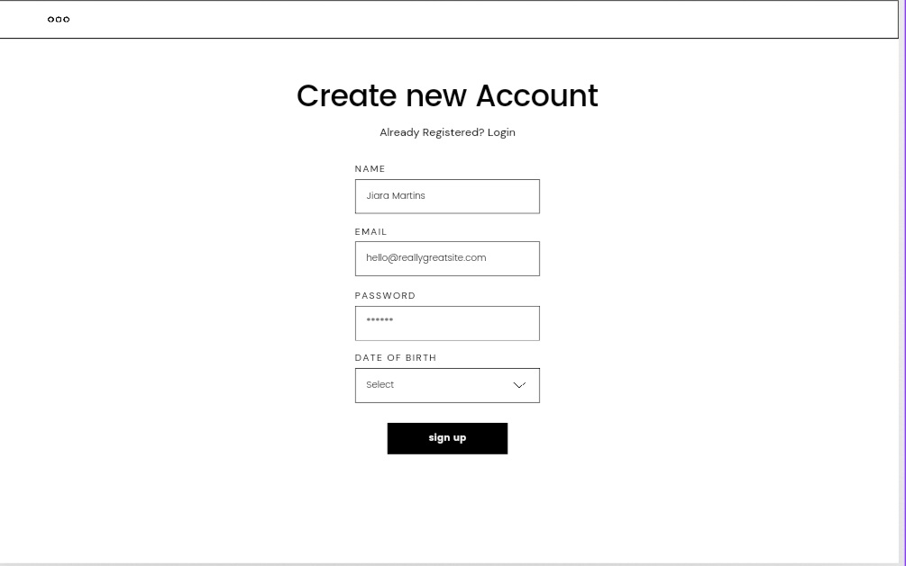
Modelling & Result

Slide 9
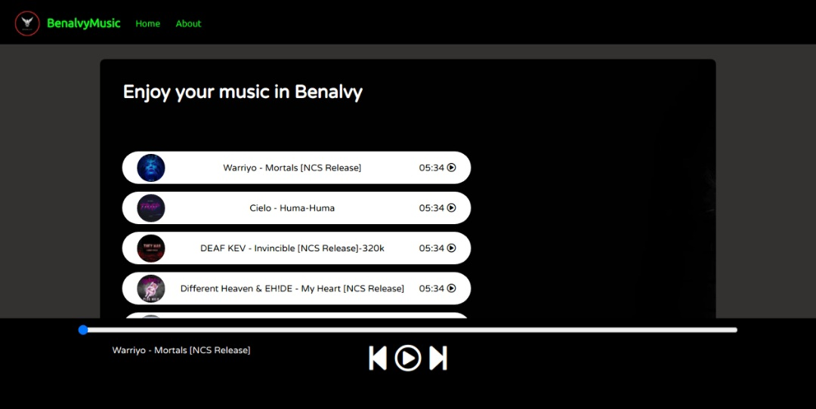
Modelling & Result

Slide 10
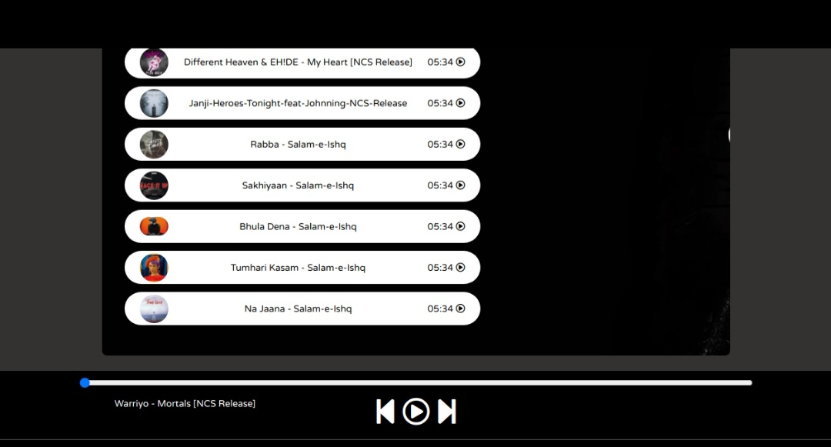
Modelling & Result

Slide 11

Conclusion
In summary, our music website offers a comprehensive solution to the challenges faced by music enthusiasts and artists alike. With features such as personalized playlists, artist empowerment tools, and a vibrant community platform, we're redefining the music streaming experience.
Additionally, our innovative approach of rewarding frequent users with exclusive incentives further incentivizes engagement and strengthens our user base. We're excited to continue evolving and providing a platform that not only connects users with great music but also rewards their loyalty and support.

Slide 12


Notes:
Thank You !!

